Slide 1
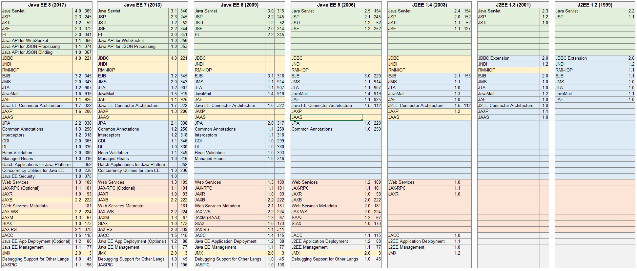
JAVA EE Overview

Slide 2
Introducing JPA
JPA – Java Persistence API
Simplifies and standardizes DB operations
Helps to maintain ORM
Model objects can be almost pure POJOs
Possibility to generate DB Schema

Slide 3
JPA Modes
JPA can operate in two modes
Resource local
Transactional
Resource local has no transaction support – you need to create and commit DB transactions manually
JTA is an EE technology that helps with transactions

